Slide 1



Fabrication Methods and Materials for Dielectric Barrier Discharge Plasma Actuators
Marianna Yanes
Mentor: Jesse Little, Assistant Professor in the Aerospace and Mechanical Engineering Department
21st Annual Arizona Space Grant Consortium Symposium
University of Arizona
April 21, 2012

Slide 2
Dielectric Barrier Discharge (DBD)Plasma Actuators
DBD plasma actuators are constructed using two electrodes separated by an insulating dielectric barrier.
When a high voltage (10-30 kV) waveform (AC or nanosecond pulse) is provided between electrodes, an electrical discharge (plasma) is formed.
This ionized air (plasma) can transfer momentum to the neutral air and can also generate shock waves.
This can have beneficial effects in many applications, but our focus is aerodynamics.

Slide 3
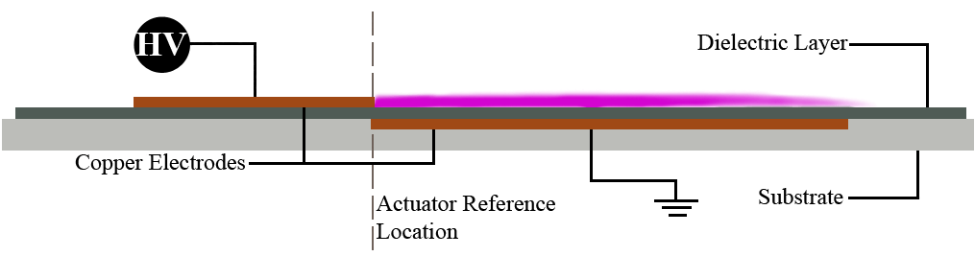
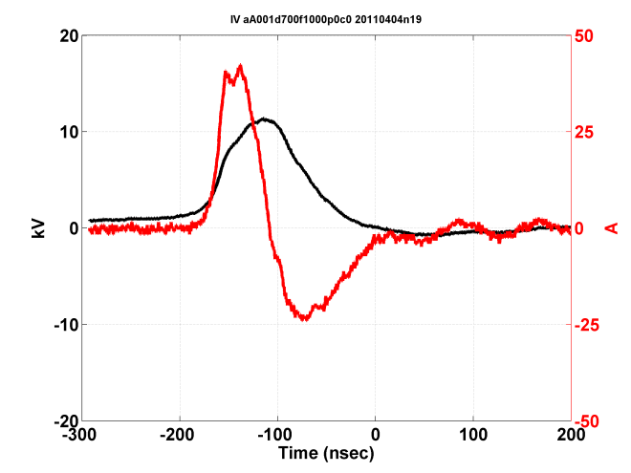
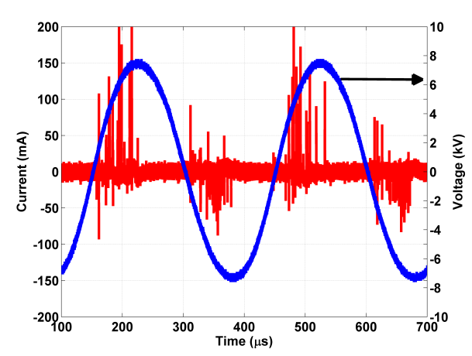
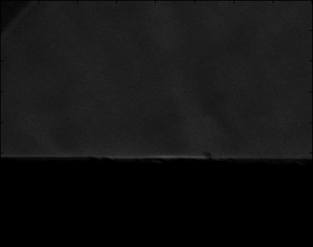
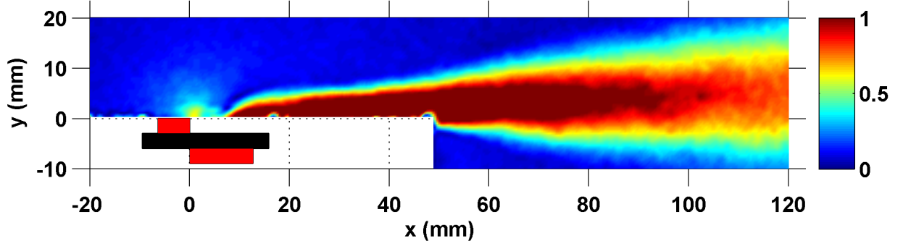
Plasma discharge
Pictures and movie from: Jesse Little

Slide 4
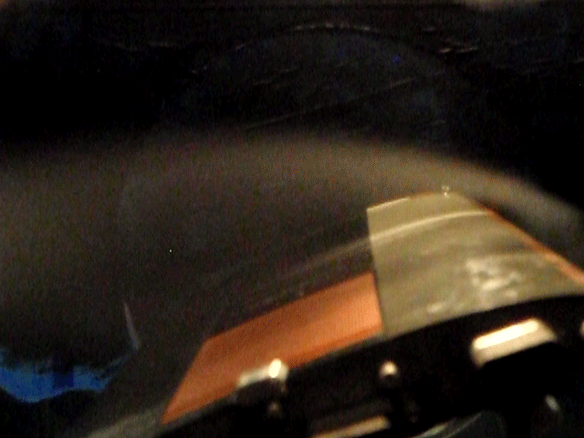
Actuator Performance
High angle of attack on airplane→ flow separation→ high drag and low lift.
Efficiency goes down → Safety problems.
Plasma actuators on wings→ prevent flow separation→ decreasing drag and increasing lift.
If flow separation is prevented, airplanes can fly at higher angles of attack.
Movie from: Jesse Little

Slide 5
What’s so special about DBD plasma actuators?
Light and simple to construct
Surface mounted with no moving parts
Minimally affect the wing when not in use → no change in aerodynamic shape.
Closed loop feedback control for smooth variations of forcing frequency and power in dynamic flight environments
There is debate on the physics underlying of these devices and their effect on the airflow

Slide 6
Impact UV Method will have
Research comes in because:
The actuator must be accurately and repeatedly constructed to allow investigation of the physics.
Studies show that:
3D designs provide a 3-D forcing mechanism that combines effects of different type of actuators.
Provide x, y, and z momentum or shock waves to the fluid.
Future studies:
Using different actuator designs is useful for uncovering unknown airflow mechanisms.
Could lead to novel, more efficient aircraft design notions.

Slide 7
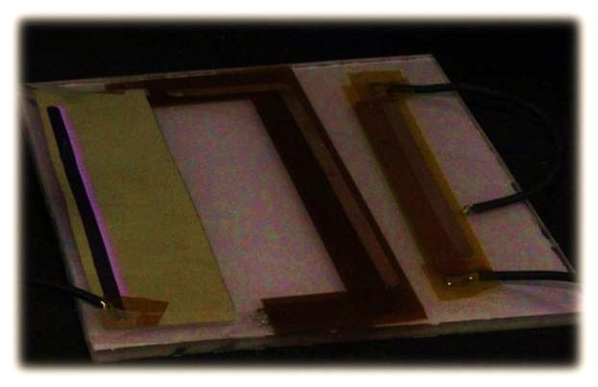
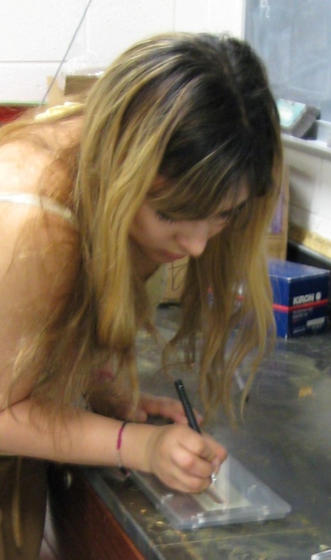
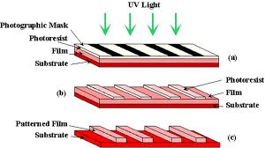
Construction Methods
Figure template
UV photoresist
Copper/ Kapton tape
Design template
Cutting with exacto knife
Tedious
Prone to deficiencies
Would be challenging for constructing 3D models.
Easiest method
Stacking metal and insulating tape
Used for printed circuit boards (PCBs)
Exposes photosensitive film with artwork to UV light and transfers pattern to board.
Exacto knife

Slide 8
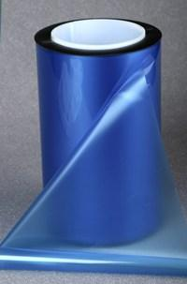
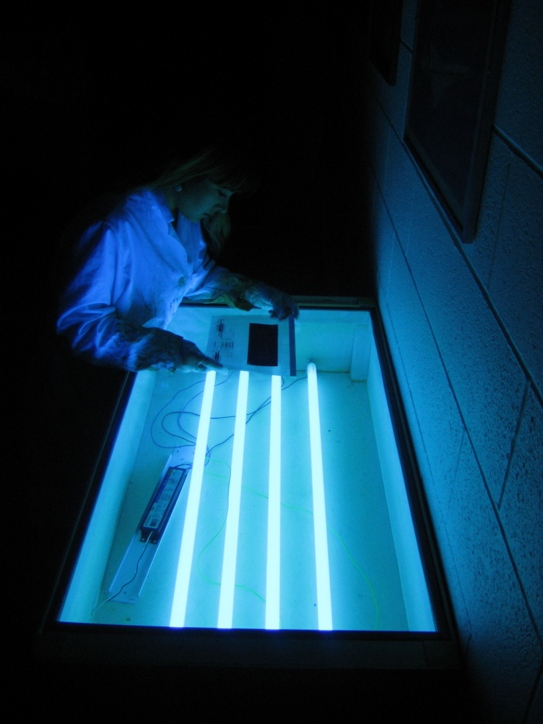
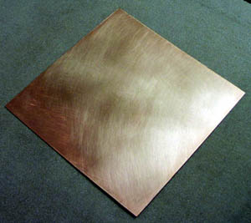
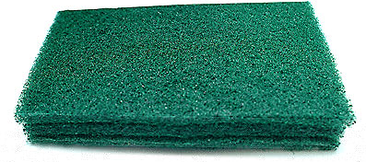

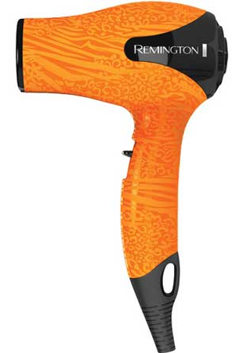

Ultraviolet (UV) Photoresist Method
Transparencies with artwork
Copper clad board
Photosensitive
film
Abrasive pad
Scissors
UV exposure system
Timer
Hair dryer

Slide 9
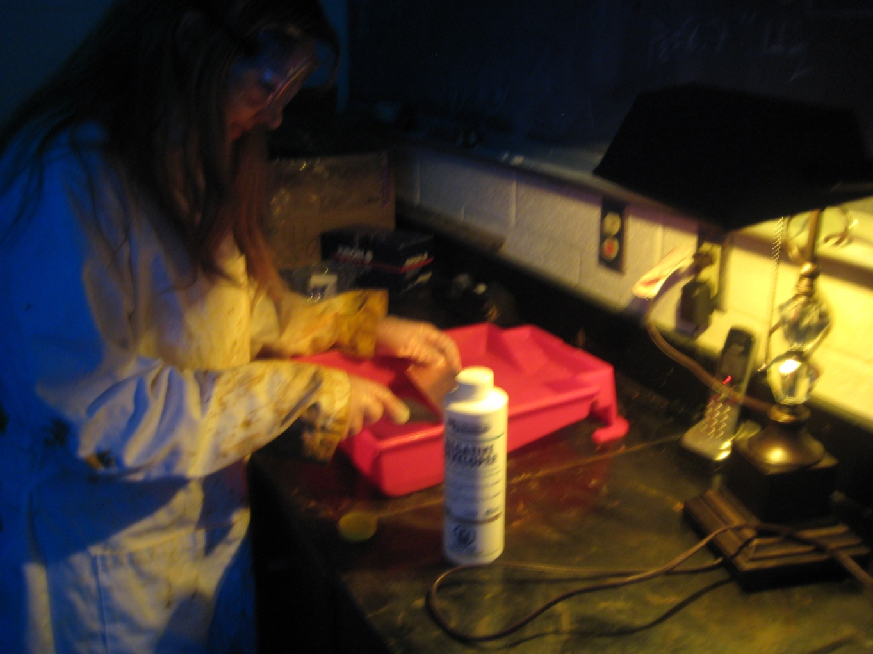
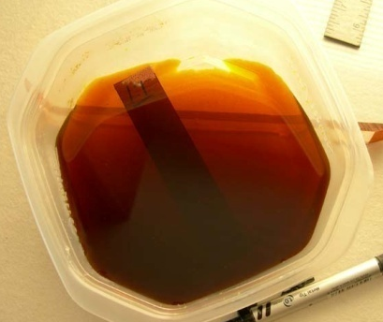
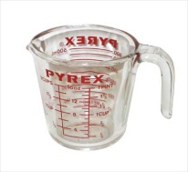
Development Process
Safety equipment
Safe light environment
+
Etching tray
Developing tray
Negative developer
Measuring cup

Slide 10
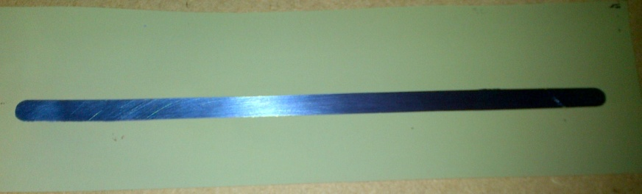
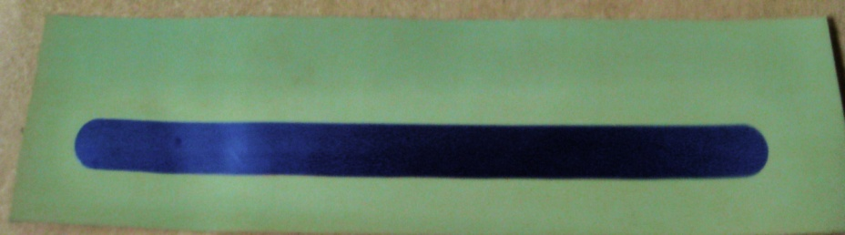
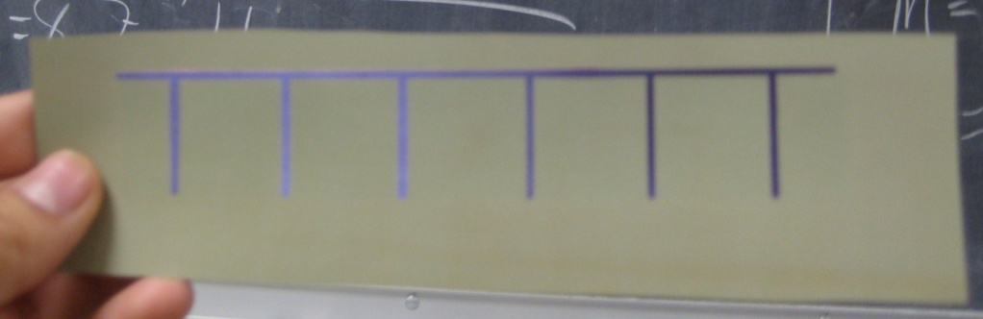
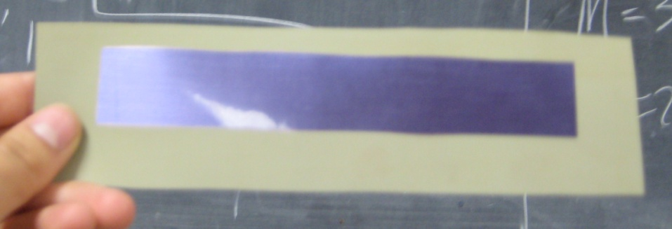
Results
Provides better quality and more repeatable actuators.
Allows for easy construction of different electrode patterns (3D).
Top electrode
Bottom electrode
2D actuator
Top electrode
Bottom electrode
Finger actuator

Slide 11
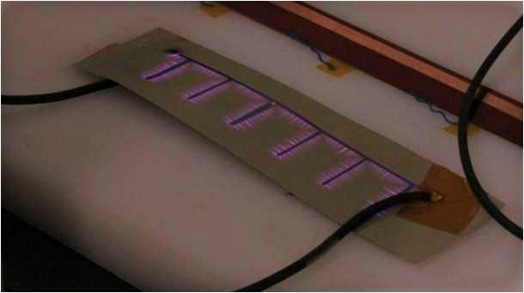
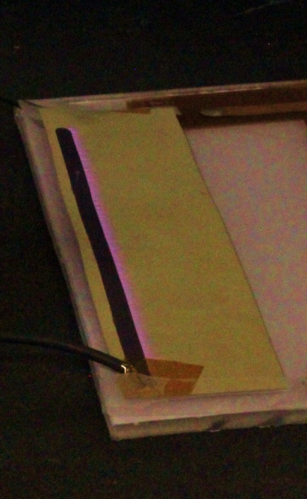
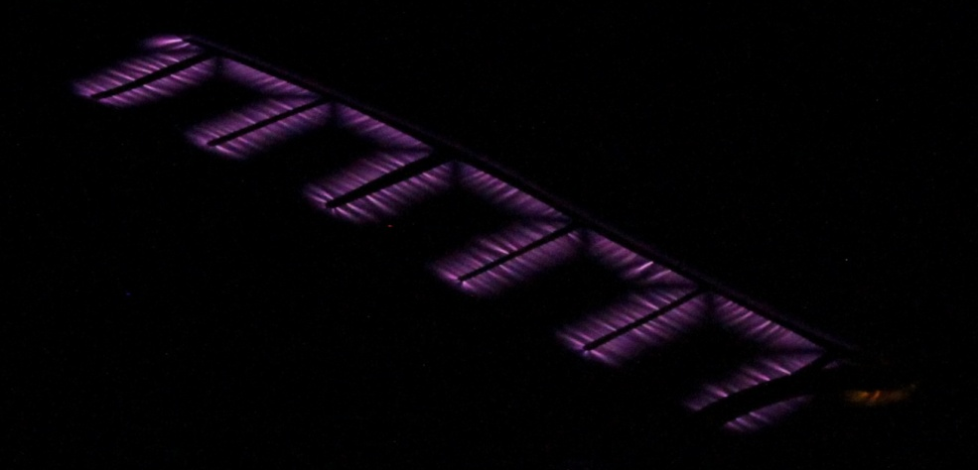
Plasma Formation
Frequency: 3kHz, nanosecond pulse ~12 kV
Light on
Tested actuator
Light off
Plasma

Slide 12
Special Thanks
NASA for granting me the opportunity.
U of A for your wonderful research and NASA affiliation.
Dr. Little, my mentor, for being an outstanding boss and instructor.
Associated Space Grant staff: Susan Brew, Tara Brode, Karis.
Dimuth, my advisor.
Shelley for keeping me updated.
Refer to uanews.org for more stories and slideshows.

Slide 13
Our plasma actuators
~ ½ mm thickness
Can fit perfectly on the surface of an airfoil
Low power (AC and nanosecond pulsed)
Nanosecond use less power than AC actuators
High amplitude and bandwidth potential
NS-DBDs = results are better in high velocities.
AC-DBDs = good results in lower velocities.

Slide 14
Dielectric and plasma
Dielectric= electrical insulator. Can be polarized by an applied electric field.
Unlike a conductor, electric charges do not easily flow.
Dielectric polarization=positive charges are displaced toward the field and negative charges shift in the opposite direction.
Plasma= gas atoms are excited to higher energy states and also ionized.
Relaxation of atoms to lower energy states→ release of photon of light→ glow discharge with color

